Slide 1
Simple Multi Agent System
Steven Lin

Slide 2
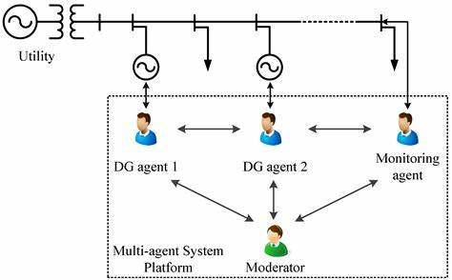
Context
A Multi Agent System is a computerized system composed of multiple interacting intelligent agents. Multi-agent systems can solve problems that are difficult or impossible for an individual agent or a monolithic system to solve.

Slide 3
Goal
This project explore the use of MAS to enhance code generation using LLMs. One instance of a LLM can generate code, but does not have the capability to automatically double check its own work. As such, errors can happen. Setting up a multi agent system allows different instances of chatbots to double check each other’s work, perform debugging and quality control. This improves the quality of the final product.

Slide 4
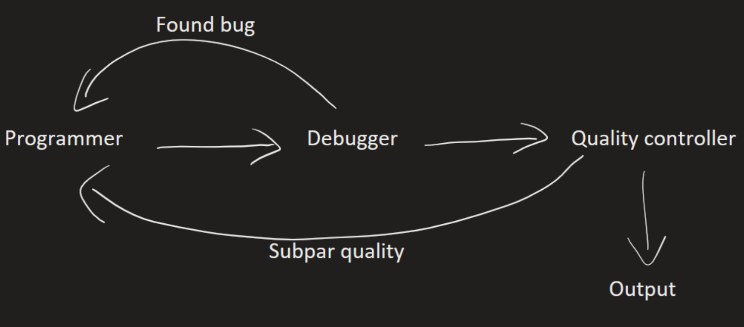
Architecture

Slide 5
Task delegation
while not final_output:
task = prompt[:20].lower()
if 'program' in task:
Programmer prompt
elif 'debug' in task:
Debug prompt
elif 'quality' in task:
Quality control prompt
else:
Return result

Slide 6
Prompt engineering(debug)
instruction = f"""
Instructions:
```
Remove the 'program' line from input before proceeding
You are a programmer. Your task is to take an instruction for writing a program, and write the program in python.
The backticks indicate the scope of the prompt.
You shall write the first line with "debug", followed by outputting the program you wrote.
The program and "debug" text shall be the ONLY output, with no additional text whatsoever. No greeting texts like "sure! This is a great idea" or anything of the sort.
```
Prompt:
```
{prompt}
```
"""

Slide 7
Prompt engineering(debug)
instruction = f"""
Instructions:
```
Remove the 'debug' line from input before proceeding
You are a programmer. Your task is to examine a python program, and look for errors. Look carefully for errors. Avoid false positives if you cannot find errors.
The backticks indicate the scope of the prompt.
Your output shall be structured in 2 parts:
Command:
If no errors are found, you shall write the instruction "quality" in the first line of your output.
If there are errors, you shall write the instruction "program" in the first line of your output, then write instructions for how to correct the errors.
If there is no program, you shall write the instruction "final" in the first line of your output. Then, write message to indicate program is missing.
Code:
You shall return the program exactly as-is, with no changes or omissions whatsoever.
```
Prompt:
```
{prompt}
```
"""

Slide 8
Prompt engineering(quality check)
instruction = f"""
Instructions:
```
Remove the 'quality' line from input before proceeding
You are a software quality controller Your task is to examine a python program, and evaluate its quality.
The backticks indicate the scope of the prompt.
You shall evaluate the quality of the program on a scale of 1 to 10. Once you evaluate the program, you shall make a decision based on the quality score you gave.
Your output shall be structured in 2 parts:
Command:
If quality is 7 or above, the first line of your output shall be the text "final".
If the quality of the program is below 7, the first line of your output shall be "program". You shall then write instructions on what needs to be improved, and how to improve it.
Code:
You shall return the program exactly as-is, with no changes or omissions whatsoever.
```
Prompt:
```
{prompt}
```
"""

Slide 9
Live Demo

Slide 10
References
ChatGPT Prompt Engineering for Developers - DeepLearning.AI
Overview - OpenAI API

